Slide 1

Data, Data, Everywhere An Introduction to Health and Information
Nick Robison
NLM Pre-doctoral Fellow

Slide 2
Who’s this guy?
My name is Nick, I’m a fairly pleasant guy
Indiana born, bred, corn fed
I wanted to be an Astronaut
I’m not an Astronaut
Electrical Engineering -> Medical Science -> Public Health
Now I live in Seattle, I work at UW, and I drink lots of coffee
We’ll talk about what I do later, so get excited for that.
Notes:
I’m Nick, I’m from Indiana, I have a personal story. I do cool things.
But enough about me, on to the next….

Slide 3
What is Informatics?
Notes:
Turn to your neighbor, introduce yourself. Apologize for your terrible morning breath.
When you hear the word ‘informatics’ what comes to mind? What types of people might do ‘informatics’? What types of things might said people do? (2 minutes)

Slide 4
In•for•mat•ics
The collection, classification, storage, retrieval, and dissemination of recorded knowledge
- Miriam Webster Dictionary
Notes:
Always start with the classic source of definitions

Slide 5
In•for•mat•ics
Some sort of watered down computer science rip-off. No one actually knows what it is, but everyone in academia likes to use the word.
- Urban Dictionary
Notes:
Maybe less reliable, but more humorous. And actually pretty true.

Slide 6
In•for•mat•ics
The scientific field that deals with biomedical information, data, and knowledge – their storage, retrieval, and optimal use for problem solving and decision making.
- Ted Shortliffe MD, PhD
Notes:
Dr. Ted is a brilliant, brilliant guy. Listen to what he says.

Slide 7
In•for•mat•ics
Informatics is using data to help understand the world and make better decisions.
- Nick Robison
Notes:
Finally, my definition.
Why did we spend 3 slides defining something? Because how we define a science determines how we apply it, and where we practice it.

Slide 8
Where does informatics impact healthcare delivery?
Notes:
Turn to your other neighbor. Introduce yourself, apologize for your morning breath.
Discuss this question. (2 minutes)

Slide 9
Everywhere
Answer:
Notes:
Here’s the right answer

Slide 10
Core Areas of Biomedical and Health Informatics
Biomedical
Clinical
Consumer
Public Health
Notes:
We’ll briefly cover the major areas of BHI, as well as some of the ongoing work and opportunities available.
Disclaimer: It’s mostly UW stuff, because we’re just that awesome.

Slide 11
Biomedical
Notes:
Let’s start at the very beginning, life itself.

Slide 12
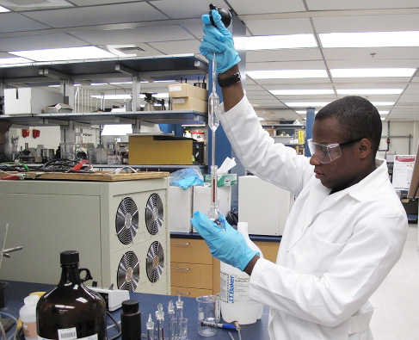
Traditional View of Biology
Flickr: REDCOM
Notes:
Traditionally, Biology has been a man and his bench. Manual experiments and ‘real’ science.

Slide 13
New View of Biology
Yngve G, Brinkley JF, Cook D, et al. A model browser for biosimulation. AMIA Annu Symp Proc 2007;:836–40
Notes:
Now, biology has taken on a an incredibly data driven persona.
Yes, we still do manual experiments, but increasingly science is being done at the computer and in simula
This is an image of the interaction of E. Coli subsystems, arranged by molecular complexity.

Slide 14
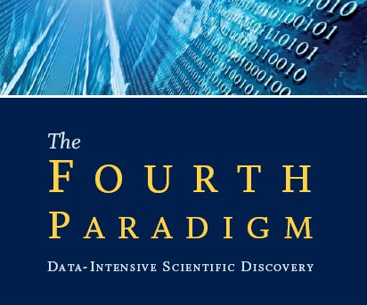
Brand new ways of doing science
Empirical Science
Theoretical Models
Complex Simulations
Data Driven Discovery
research.microsoft.com
Hey T, Tansley S. The Fourth Paradigm. 1st ed. Seattle, WA: : Microsoft Research 2009.
Notes:
First, we had empirical science. Ways to describe natural phenomena (waves, solar orbits, bacterial growth rates). Paracelsus, anyone?
Next, theoretical science. Thinking about things we can’t see (quantum physics, proteomics)
Third, complex simula. Ways to model really big problems (CERN, climate models, etc.)
Finally, the 4th paradigm, the shift away from hypothesis driven science, into using data to discover new ideas and mechanisms.

Slide 15
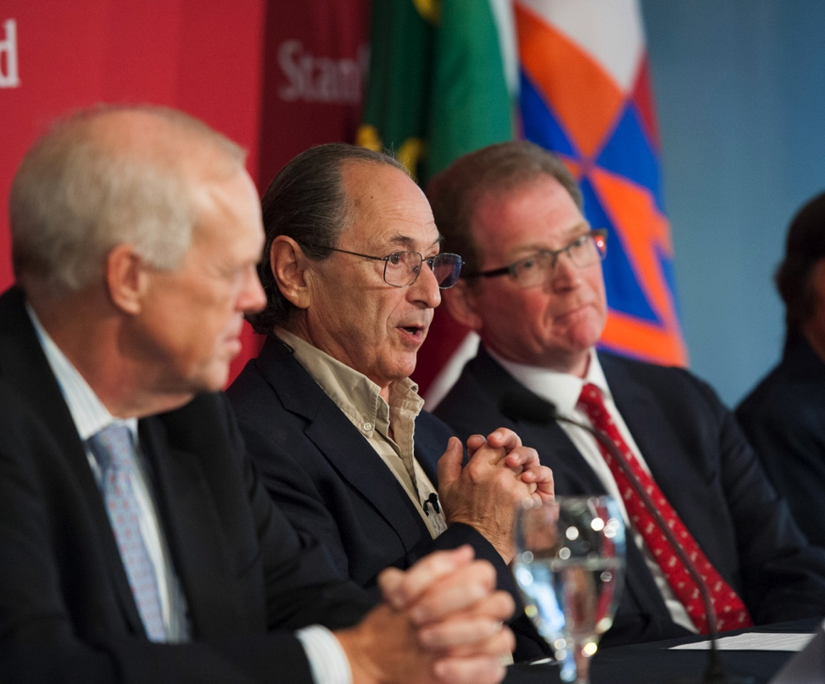
Michael Levitt, PhD
2013 Noble Laureate in Chemistry
med.stanford.edu
Notes:
Michael Levitt, the first bioinformatician to win the Nobel.
Developed molecular simulations for complex chemical systems.
Squarely in the 3rd paradigm.

Slide 16
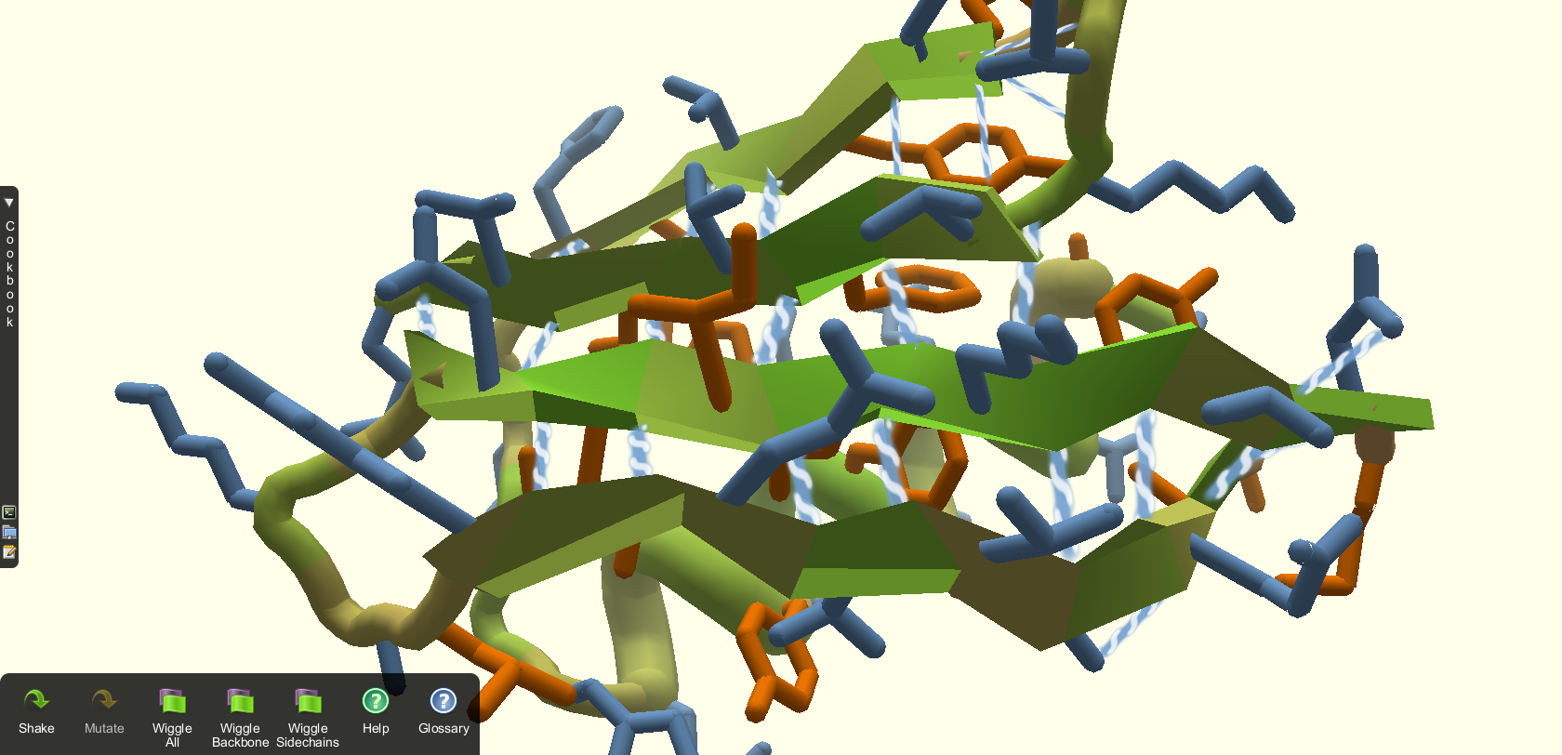
Fold.it
fold.it
Notes:
DEMO: Fold.it game (Not going to do this)
Project developed at UW to help discover lowest energy protein folding. Turns out, humans are really good at this, and if you make it a game, they’ll waste hours solving those problems.
Here, we’re applying new techniques towards solving problems that even 10 years ago, would’ve been impossible.

Slide 17
Clinical
Notes:
When I say ‘clinical informatics’ what’s the first thing you think of? (shout it out, or not)

Slide 18
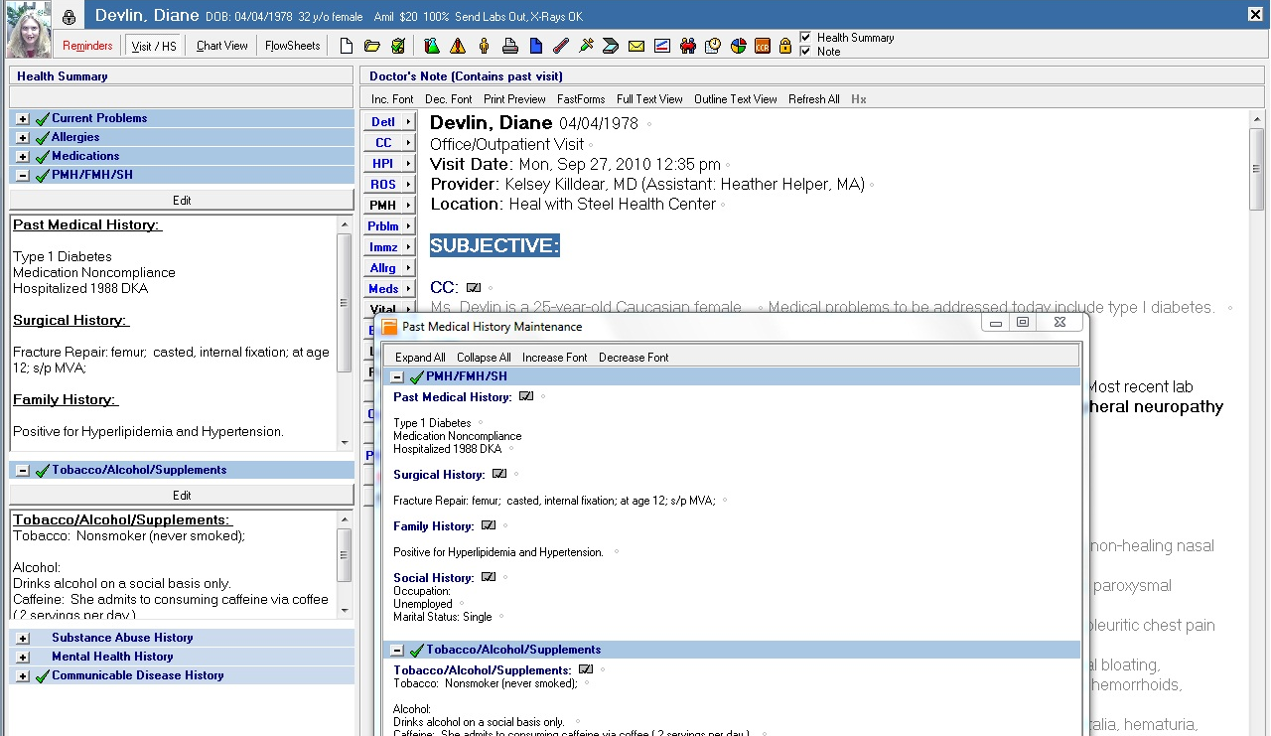
EHRs
ehrscreenshots.com
Notes:
The classic EPIC EHR, these are the new nerve centers of the hospitals

Slide 19
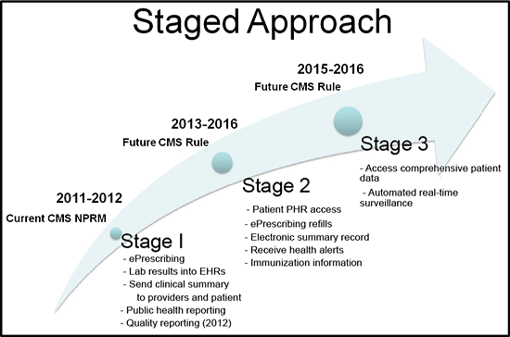
Technology + Policy
dhhs.alaska.gov
Notes:
Clinical informatics is really being driven by current policy changes.
Meaningful use was written into the ARRA

Slide 20
Decision Making
Notes:
DEMO: Using reasoning to discover treatments and associations between prenatal diseases

Slide 21
Consumer
Notes:
Consumer Informatics, is working on integrating people and healthcare. Increasing ownership of their lives and lifestyles.

Slide 22
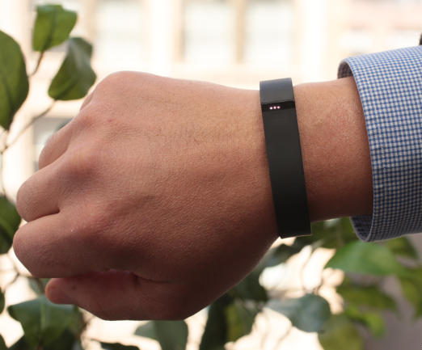
Quantified Self is a Big Deal
reviews.cnet.com
Notes:
What is this? (It’s a FitBit)
There’s a huge push right now to begin changing the way we live our lives and interact with the world.
It used to be just nerds that cared about biofeedback and quantified self, but now everyone’s doing it.

Slide 23
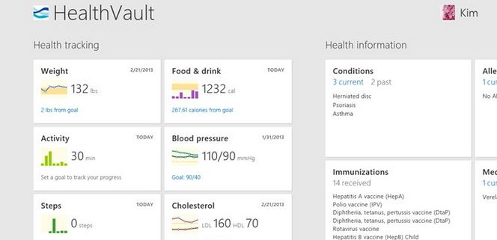
HealthVault
microsoft-news.com
Notes:
Increasingly, we have the ability to take ownership, and management of our own healthcare and outcomes.
This is the future of ‘patient empowerment’
Of course, the real challenge is getting people jazzed about health.

Slide 24
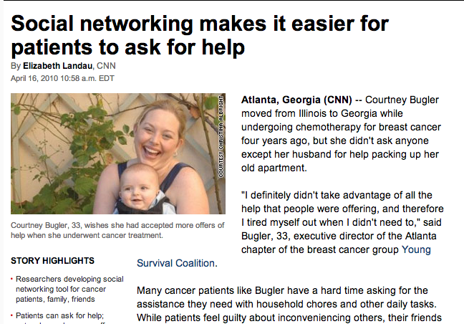
Online Communities
cnn.com
Notes:
Some more UW projects. Developing online communities for cancer patients and care providers.
Focuses on how people interact with technology and build trust online.
Really interesting work, extremely qualitative and impactful.
Dr. Wanda Pratt, the PI, is the bomb.

Slide 25
Public Health
Notes:
Public Health has the potential to see tremendous improvements through the application of informatics

Slide 26
Characteristics of Public Health
Population focused
Revolves around prevention
Primarily government driven
Koo D, O’Carroll P, LaVenture M. Public health 101 for informaticians. J Am Med Inform Assoc 2001;8:585–97.
Notes:
It’s important to review some of the major differences between public health and clinical science as it fundamentally changes the way we approach

Slide 27
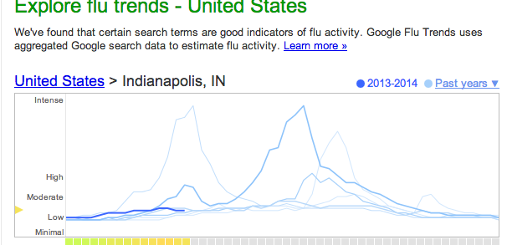
Google Flu Trends
http://www.google.org/flutrends/us/#1017146
Notes:
DEMO: Google Flu Trends
We can use new types of data to monitor for potential outbreaks, Google’s method is cheaper and faster (by up to 3 weeks) then traditional CDC sources such as hospital admission records
There was a bit of a problem last year, people got freaked out and googled a bunch of stuff, which threw off the results. Still, it’s nice to have 2 sources to verify ‘truth’

Slide 28
DEMO
King County Public Health Outbreak
Notes:
Let’s look at a ‘real life’ example
This a demo we did for a high school in South King County

Slide 29
Demo: Public Health Data
Notes:
This is a chart of the incidence rate of gonorrhea in King County. (What’s incidence rate?)
Just looking at this chart, what can you tell?

Slide 30
Demo: Public Health Data
Notes:
What about this chart? (Those race deliniations come from the US Census Bureau)
Who are the highest risk populations?
If you’re a public health officer, what do you do? How do you intervene, remember, we’re focused on prevention

Slide 31
King County GIS
Notes:
DEMO: GIS Application
Using GIS applications we can help to determine the optimal use of public health resources to control Gonorrhea outbreaks.
Ctrl + Shift + F to zoom to full
Ctrl + Shift + I to select feature

Slide 32
Why Would One Study Informatics?
Notes:
Why would I choose informatics amongst the sea of other health careers?

Slide 33
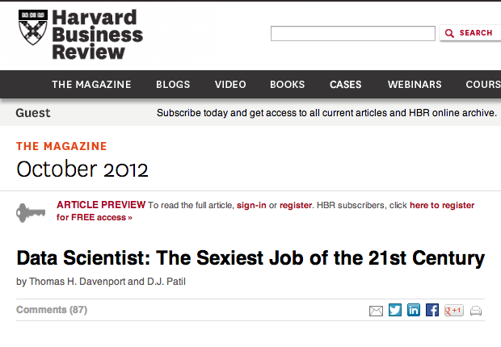
Sexiest Job of the 21st Century
If Harvard says so, it must be true.
http://hbr.org/2012/10/data-scientist-the-sexiest-job-of-the-21st-century/
Notes:
Data Science, is just a pedestrian term for informatics.
It’s going to be huge. Also, Facebook’s IPO created the wealthiest zip code in the US

Slide 34

We’re Cool People
Hilary Mason
Data Scientist in Residence
Accel Partners
http://www.hilarymason.com/
Notes:
Previously, she was the Chief Scentist at Bit.ly. I don’t really know what they do, but she’s really smart.
She’s also emblematic of everything that’s wrong with the Internet, all her examples involve Cheeseburgers, lolcatz, or lolcatz with Cheeseburgers.
Accel is a huge company, they invest is a lot of stuff, so the fact that they have a data scientist on board, means they take this stuff very seriously.

Slide 35
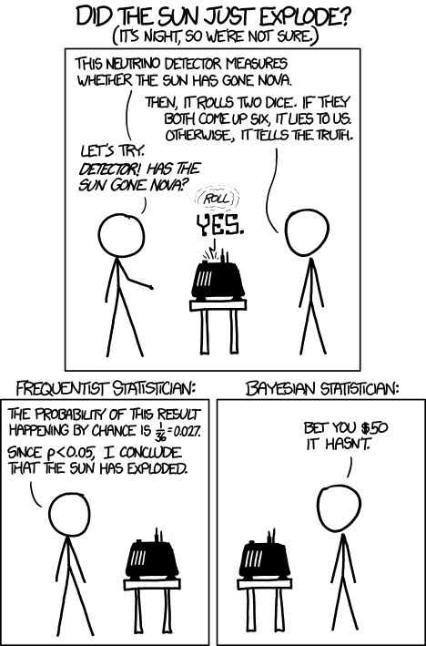
You get to understand cool jokes
xkcd.com
Notes:
I like this one a lot.

Slide 36
What’s it like to be an informaticist?

Slide 37
What’s it like to be an informatanaut?
Notes:
I like the term ‘informatanaut’ it sounds more exciting. One who explore the uncharted regions of information!
So what’s it like? It’s really cool. I would tell you, but I’d be wrong before I finished the thought. So I’m going to tell you what I do instead. Briefly.

Slide 38
What do I do?
Technology + Policy
How do we do large-scale data mining on protected medical data?
Traditionally, hospitals have lots of beautiful data, but very little computing power
Computing centers, have lots of power, but very little security, or access controls
How do we do research while respecting the rights of patients and the rights of compilers?
Notes:
My research is a bridge between the clinical world, and the computing world. We’re working on using virtualization techniques to create encrypted ‘containers’

Slide 39



How it might work
(if it ever actually works)
Notes:
Let’s say you have a clever research who wants to know if patients, who go on insulin, ever come back off it. And if they do, what factors do they have in common?
He’s got all this data sitting at a hospital (like Parkview Medical Center in Fort Wayne), but no computers with enough gas to sort through all the records.
Over at Purdue, they’ve got some serious computer power. Like 28th fastest in the world serious.
So, how do you get the data you want, into the computer you need, whilst keeping people happy and healthy.
This matters, because you need for computational power isn’t going to decrease over time. What we need is a technical and regulatory environment that allows us to do this type of research easily, and safely.

Slide 40
That’s boring, what else can I do?
Be an academic
Work at a hospital
Work for the Government
Work for a University
Work in private industry
Notes:
Faculty positions abound, it a myriad of departments. We have people in HCDE, Information, Medicine, etc. My program orients around academia
EHR systems require A LOT of custom code and manual labor, you can do that. Also, Health IT has a huge role in management/leadership
Policy wonk for DHHS, one of our alums is the health minister of Peru
Again with the University, researcher, lab tech, developer
Only if you quit at life, not really, this is a cool field. Consultant, developer, vendor systems, etc.

Slide 41
Intriguing, how does one become an informaticist?
(How to get your nerd on)
Notes:
Now that you’re all jazzed about this new field, you’re probably wondering how to get started?

Slide 42
Steps to Nerdery
Get a degree in something health
Public Health
Medical Science
Take classes in other fields
Intro to Programming + High Performance Computing
Research Methods
Biostatistics
Get an advanced degree
Med School + Fellowship
Graduate School (MS/PhD)
Notes:
Here’s how to go about it:
Purdue’s Health Sciences program provides an excellent path towards informatics, in that it allows you to take a variety of classes and get experience in a ton of different areas. Take advantage of that.
Also, if you really want to be a doctor, you still can. But you probably shouldn’t.

Slide 43
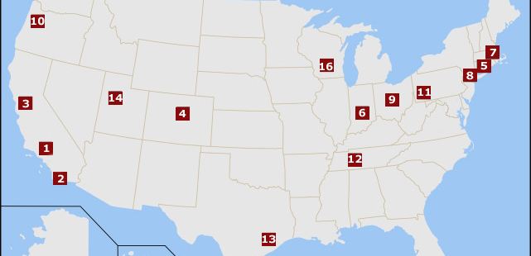
Where should I study?
(Seattle, end of story)
http://www.nlm.nih.gov/ep/GrantTrainInstitute.html
Notes:
The NLM provides funding for informatics students, as well as monitors the basic competencies of the programs. You should go to one of their ‘approved’ schools. It’ll save you a bunch of time/money.
Each program has a slightly different focus, some are more genomic (Stanford). Some are really clinical (IU, Utah, Harvard). Some are biological (Rice), some are heavy public health (Columbia). Some are really lame (OSU, kidding of course).
So, I was asked to talk a bit about what it’s like to be a grad student

Slide 44
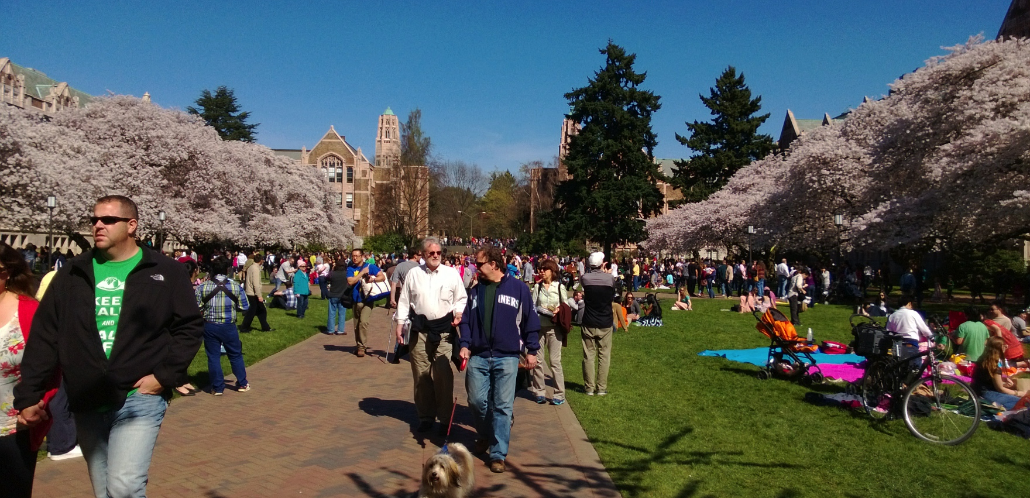
This is UW
Notes:
This is UW in the spring

Slide 45
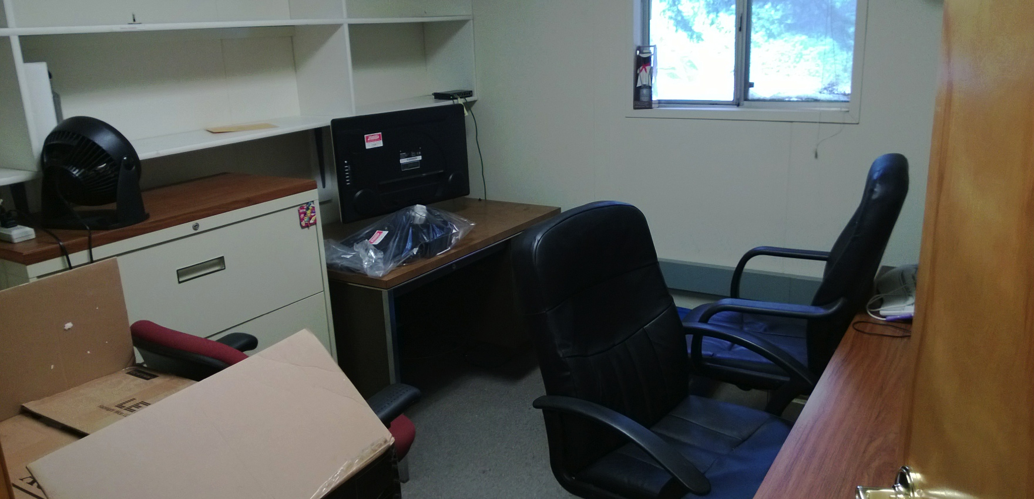
This is my old office
Notes:
This is my old office.
It’s called ‘Annex 4’, it was supposed to be demolished about 20 years ago. It floods, there was a homeless guy living in it, it smells like death. But I had a locking door.
Now we’re in a much fancier building, so it’s all good. But I have cube now, with no door.

Slide 46

This is Seattle
Notes:
Notice the puny space needle in the center.
Also, mountains. I could only fit the Olympics

Slide 47
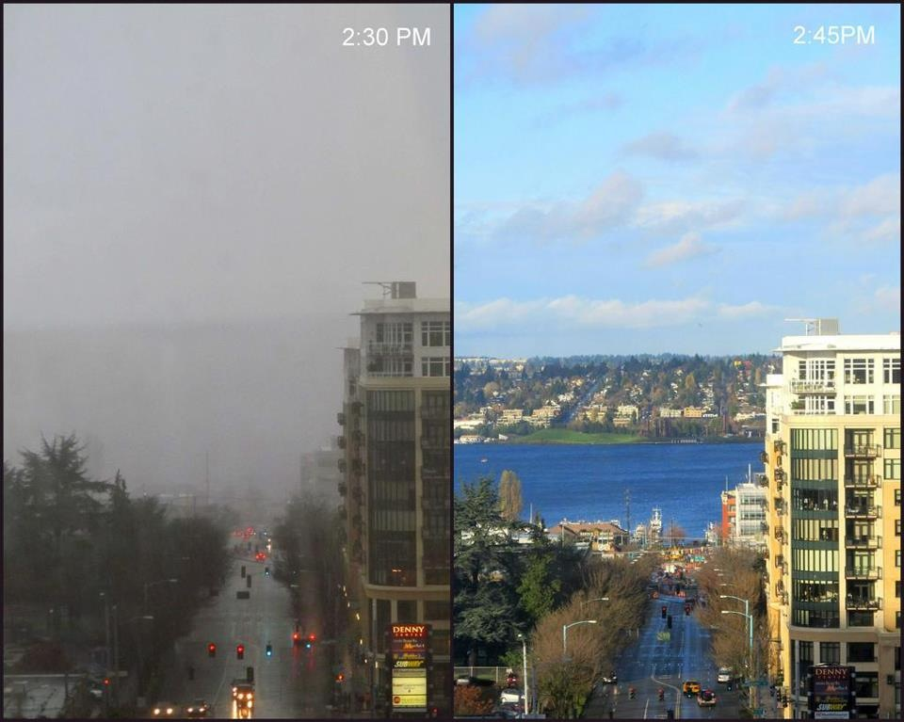
This is real Seattle
Notes:
This is 15 minutes. For real.

Slide 48

Notes:
The obligatory shot of the space needle, which is right outside our offices. You can see it from the conference rooms.
We’re also right between Amazon and the Gates Foundation, which is a cool place to be.
If I may leave you with a final thought:

Slide 49
Informatics is everywhere
Informatics is more than data
Notes:
Even if you’re not a nerd, and don’t get pumped over index optimization for distributed search systems, or didn’t like/understand the XKCD joke. That’s ok, you can still be an informaticist, or benefit from informatics.
Also, it’s inevitable, resistance is futile. We are the future.
Also, ok 2 points. It’s more than data, it’s about how we use technology to make people healthier, to improve lives. It’s about tackling the challenges of tomorrow and refusing to admit ‘this is as good as it gets’. It’s about applying creative solutions to common problems.
Informatics is a jumping off point, it’s a way to declare to the world, as it says on the side of my building, ‘From here, we change the world’.

Slide 50
Questions?
nrobison@u.washington.edu
www.nickrobison.com
@nickrobison
github.com/nickrobison
Notes:
If you have any questions, I’d love to chat with you.
The slides are available on github, and will be on the course website.
I’m incredibly personable in person, but probably even more appealing over the phone/internet

